Slide 1
MULTI PAGE WEBSITE FOR SCHOOL MANAGEMENT SYSTEM

Slide 2
PROJECT GUIDE MS. S CHANDRAKALA DEPARTMENT OF MCA SCIENCE AND HUMANITY
REGISTER NO – RA1832241010003
NAME SACHIN.C

Slide 3
INDEX PAGE
ABSTRACT
EXISTING SYSTEM
PROPOSED SYSTEM
PROJECT STRUCTURE
MANAGEMENT SYSTEM AND SOFTWARE
FLOW CHART DIAGRAM
DFD - DIAGRAM
ER – DIAGRAM
WEB SITES SCREEN SHORT
CONCLUSION

Slide 4
1. ABSTRACT
• Many of schools and university across the world have transmitted into fully online experiences with the recent pandemic with each school’s backend stack witnessing new highs in usage in educational system.
• As we all know the days we are facing today with virus so in this situation we can’t leave our education system for that we are working here to maintain knowledge with power.
• Structure database solutions are more important than ever. Here’s a walkthrough on how to create a ‘Multi-page Website School Management System’ using “HTML, CSS, JS,BOOTSTRAP” for identify library system management, with “MySQL DB” as a Server side database.
• MySQL DB allows us to create SQL databases with provides an altogether different mechanism for storage and retrieval. You can perform as many reads/write as you desire.
• Here we can manage our student database for later retrieve and manipulation
• Many of schools and university across the world have transmitted into fully online experiences with the recent pandemic with each school’s backend stack witnessing new highs in usage in educational system.
• As we all know the days we are facing today with virus so in this situation we can’t leave our education system for that we are working here to maintain knowledge with power.
• Here we can manage our student database for later retrieve and manipulation use.

Slide 5
2.EXISTING SYSTEM
Here todays day to day life every parents are busy with their work, they couldn’t have time come across school see the performance of their child so, this system will helps to come out of this problem.
This online school management system will help them to retrieve the full data about their child recoded in school.
As we all know that maintaining the data and information about the student manually in one piece of paper is very hard.
This management system will record all details about the student like profile information, fees details, student tests and exams results and achievements.
In this existing system the admin will authorized for manipulate data to the right student.

Slide 6
3.PROPOSED SYSTEM
This School Management System will be fully computerized with Web based application.
In this Proposed System Student, teacher and parents can access this application and see the data with their usually provided id and register number password.
It will have its own domain and server system to store information for further requirements.
This management system will save time, and it is eco- friendly.
High firewall security software will be installed to safe from threats and data damage and sharing security.

Slide 7
4.PROJECT STRUCTURE
AADMINISTRATIONISSS
EXAM
STUDENT
DEPARTMENT
SCHOOL MANAGEMENT
STAFF MEMBER
COURSES

Slide 8
5.MANAGEMENT SYSTEM SOFTWARE
SYSTEM NEEDED
- PROCESSOR : Intel i5 7th gen
- OS : WIN-10
- RAM : 2GB
- HDD : 50GB
SOFTWARE NEEDED
- FRONT END : HTML,CSS,JS,BOOTSTRAP
- BACKEND END : MYSQL DB
- SERVER : XAMPP
- IDE : VS. Code

Slide 9
6.USECASE DIAGRAM
LOGIN
ADD BRANCH
ADD STAFF
MODIFY BRANCH
ADMINSTRATION
ADD STUDENT
ADD ATTENDENCE
STUDENT
MODIFY ATTENDENCE
VIEW RESULTS
LIST OF SUBJECT
STAFF
FEES DETAILS
CLASS MANAGEMENT
USER MANAGEMENT
LOGOUT

Slide 10
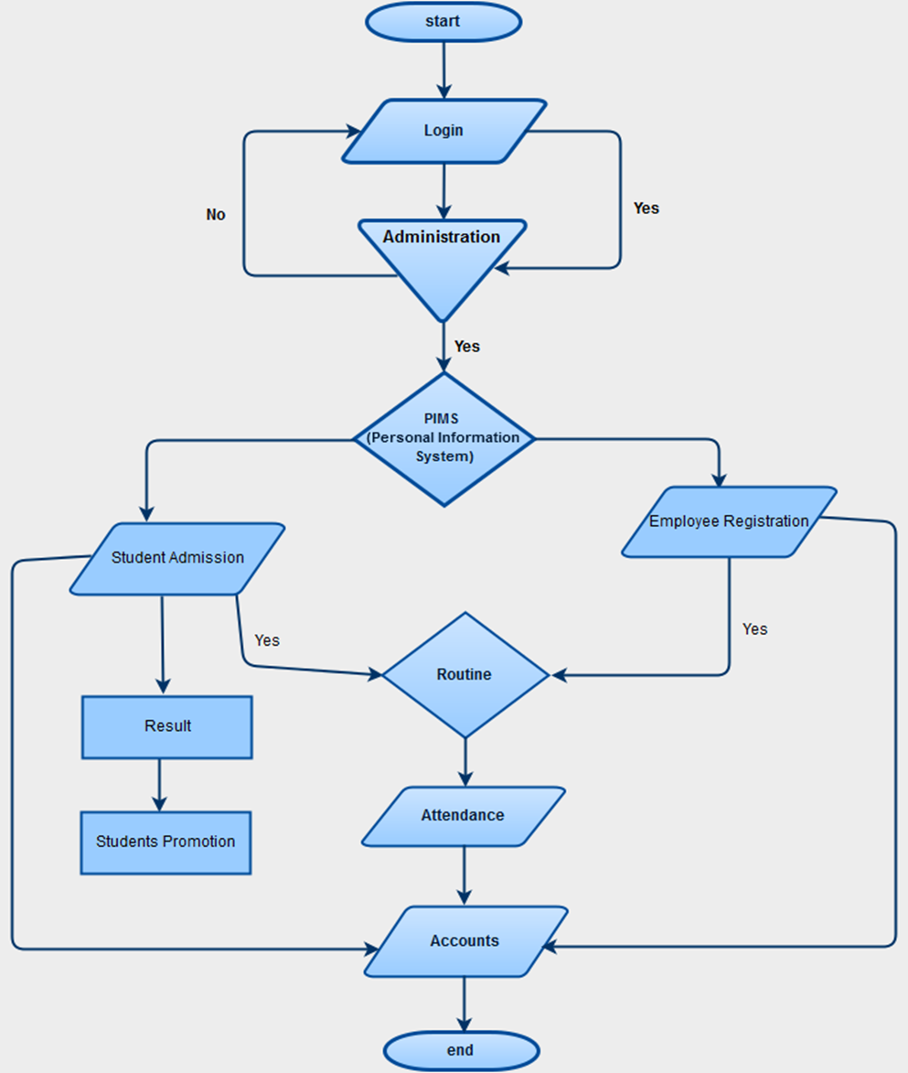
7.DATA FLOW

Slide 11
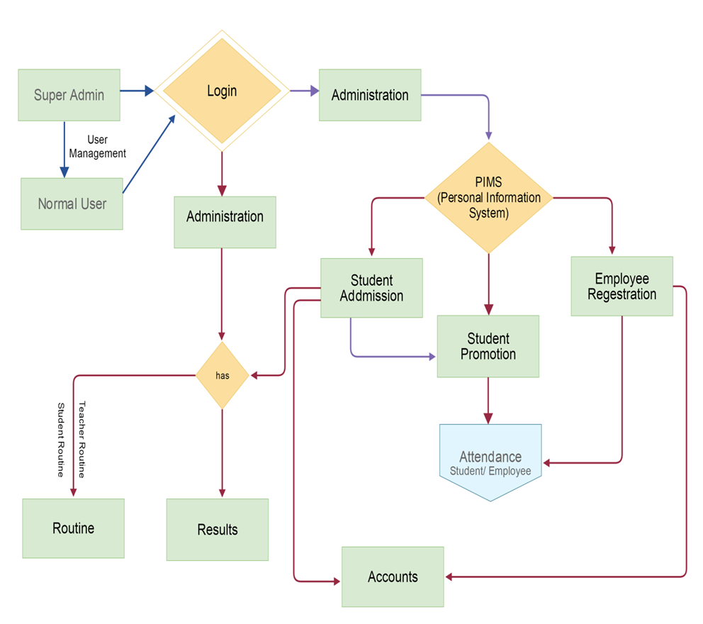
8.ER DIGRAM

Slide 12
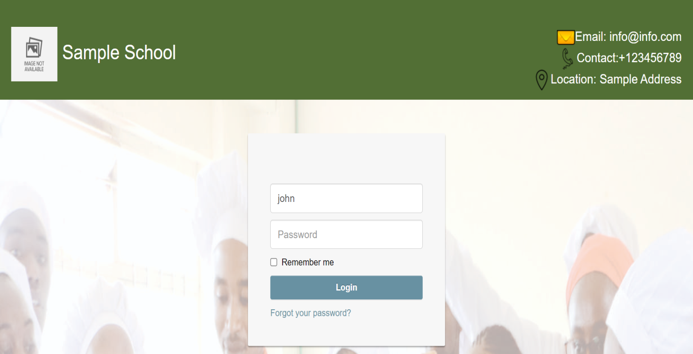
9.WEBSITE TEMPLETE
Admin login

Slide 13
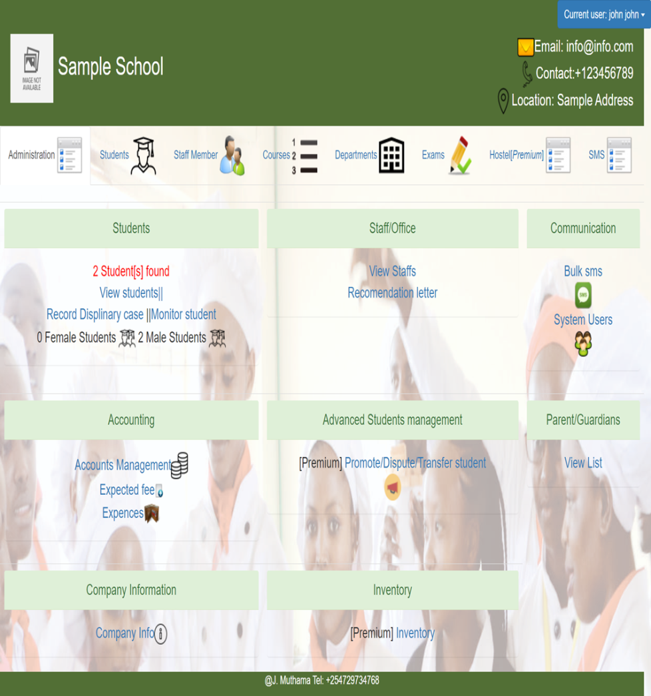
WEBSITE PAGE

Slide 14
10.CONCLUSION
We proposed school management school in which the administration will upload the data like Students Records and Teachers allotment, assignment etc.
This web based application will be process all running activity of organizations under school management.

Slide 15
THANK YOU

